Slide 1

María José Villegas Muñoz
(Public Housing Company of Málaga), AVS, Spain.
Housing Europe/EIB joint workshop on March 5th 2020 in Brussels

Slide 2
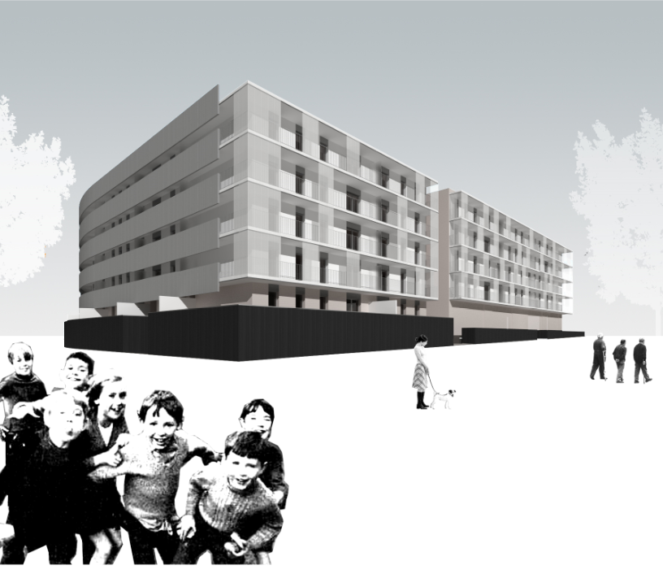
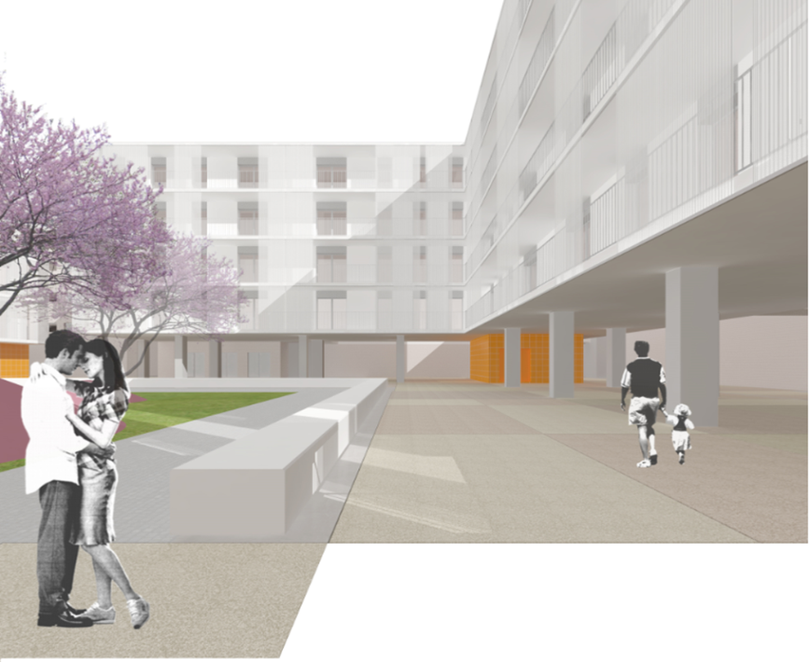
NEEDS OF HOUSING IN MÁLAGA (LACK OF HOUSING FOR RENT)
MORE THAN 20.501 FAMILIES ARE REGISTERED ON THE WAITING LIST FOR VPO PROPERTIES TO PURCHASE OR RENT.
82% OF THEM PREFER TO RENT.
75% OF THEM ARE AGED UNDER 35 YEARS OLD.
THERE ARE MORE THAN 12,600 REGISTERED WHO ARE UNDER 35 YEARS OLD AND WITH ANNUAL INCOME BELOW 7.432 € PER YEAR
HOW THIS EIB COMPANY REPRESENTS AN ADDED VALUE FOR THE CITIZEN OF MALAGA.
THE MALAGA CITY COUNCIL HAS 9 PROJET FOR THE CONSTRUCTION OF 1001 PUBLIC HOMES ON LAND WEST OF TEATINOS CAMPUS EXTENSION.
THE EUROPEAN INVESTMENT BANK (EIB) FINANCES THIS OPERATION WITH € 70 MILLION OF THE DEVELOPMENT COSTS € 143 MILLION, INCLUDING URBANIZED LANDS.
THE COST OF THAT LOAN WILL ONLY IMPACT THE FAMILIES IN THE FORM OF RENTS, (FROM € 250 TO €400 PER MONTH TO BE AFFORADABLE).

Slide 3
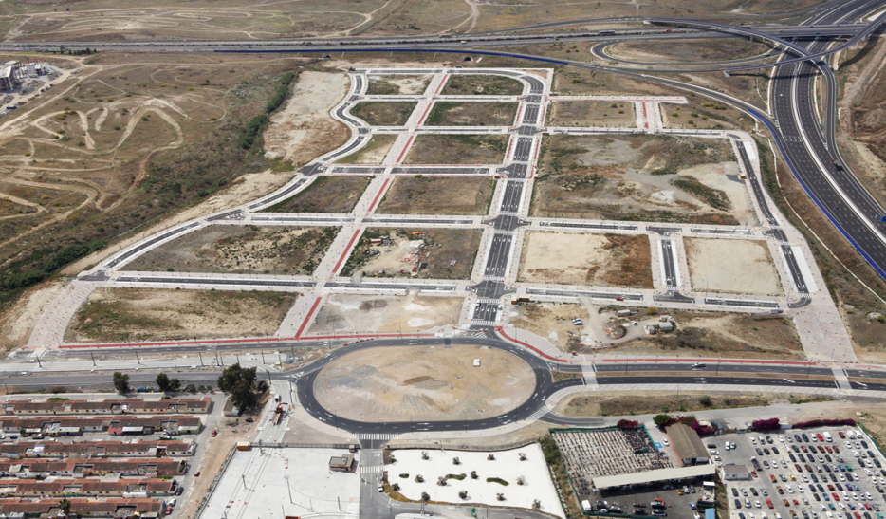

ACHIVEMENTS OF 9 DEVELOPEMETS IN SUP.T-8 UNIVERSIDAD, MÁLAGA. ( SPAIN)
-SUSTAINABLE PAY BACK ( INTEREST AND LOAN) TO EIB.
-ENERGY PERFORMANCE OF NEW BUILD UNITS, AT LEAST RATING (B)
PROJETS BENEFITS AND CONTRIBUTION OF EIB WITH THE MALAGA CITIZENS:
CREATE A COMPLETE COMMUNITY OF EFFICIENT BUILDINGS IN A LOCATION WITH GOOD COMUNICATIONS, WITH SPACES EQUIPPED WITH PARKS, SCHOOLS, COMUNITY CENTERS …
ALLOWING YOUNG GENERATIONS TO START THEIR LIFES “AFFORDABLE”.
ENERGY EFFICIENCY THAT WILL PROVIDE A MORE SUSTAINABLE LIFE FOR THE FAMILIES.
POSITIVE PROJETS WITH BENEFITS FOR THE CITY, WITH SUSTAINABILITY ON BOTH THE LONG-TERM FINANCIAL OPERATION, SINCE THE LOAN IS PAID WITH RENTAL INCOME.

Slide 4
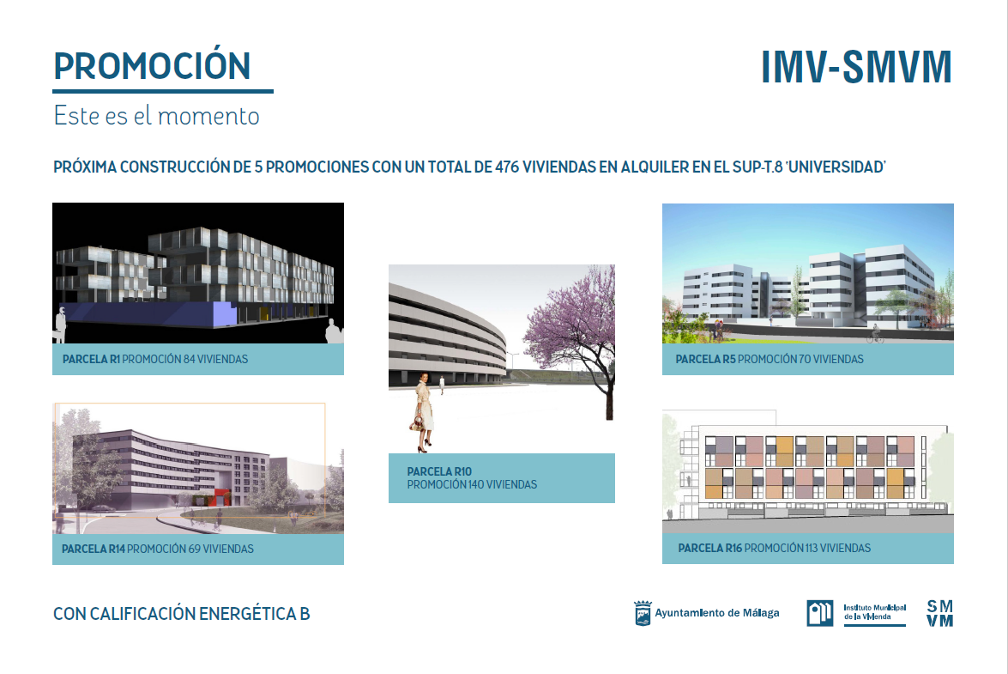

Slide 5
THANKS YOU
FOR FURTHER INFORMATION PLEASE CONTACT THIS EMAIL
mjvillegas@malaga.eu

